Slide 1
Virtual Concierge
https://github.com/BrassM0nkeyy/virtual-concierge

Slide 2

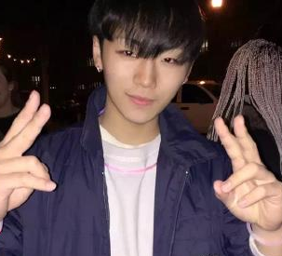



About Us
Eric Quan
Matthew Grech
https://www.linkedin.com/in/shengxu-quan1/
https://www.linkedin.com/in/matthew-grech-6b6a56162/

Slide 3
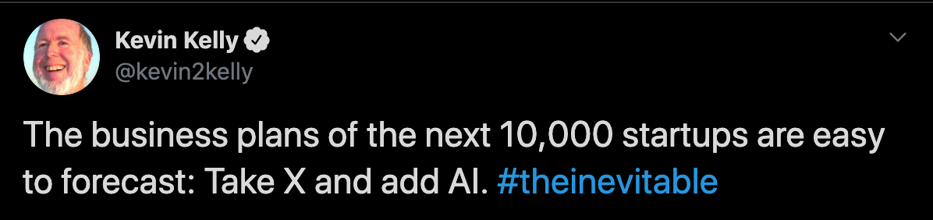
Making things smart

Slide 4
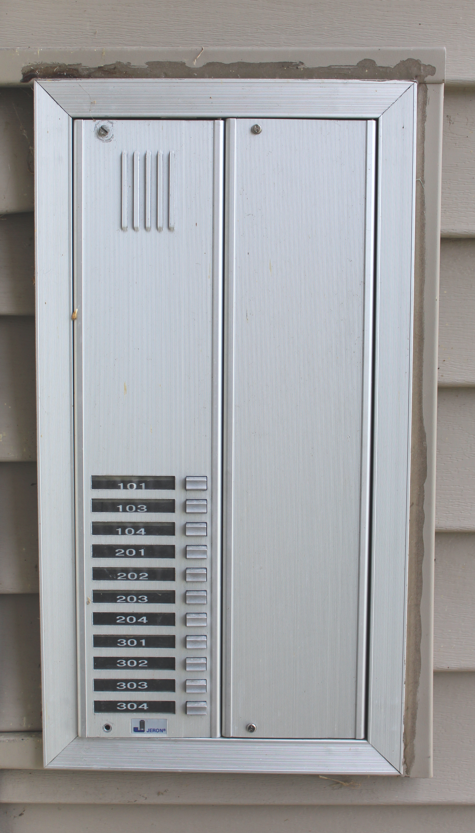
The Problem

Slide 5



Slide 10
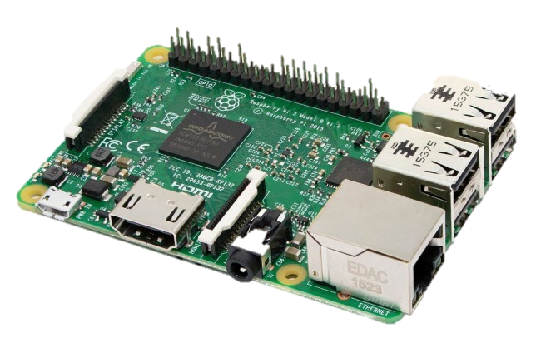

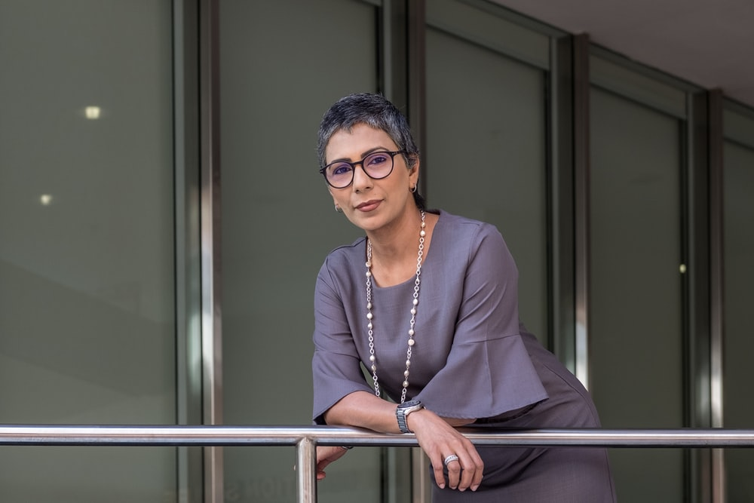


Demo Implementation

Slide 11

Uses
Similar implementation is being used for a local art school by our office

Slide 12
Tinkering
Opens door
Audio in/out

Slide 13
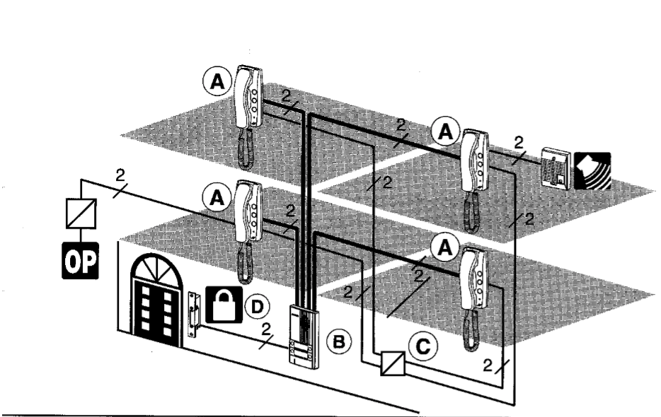
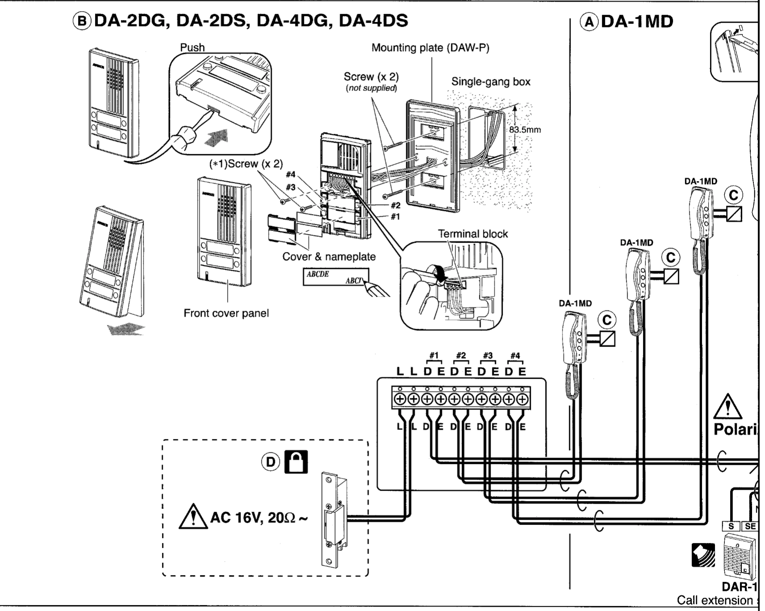
Tinkering

Slide 14



Limitations
DEMO

Slide 15

Get Creative

Slide 16

Does Anyone Have Experience?

Slide 17
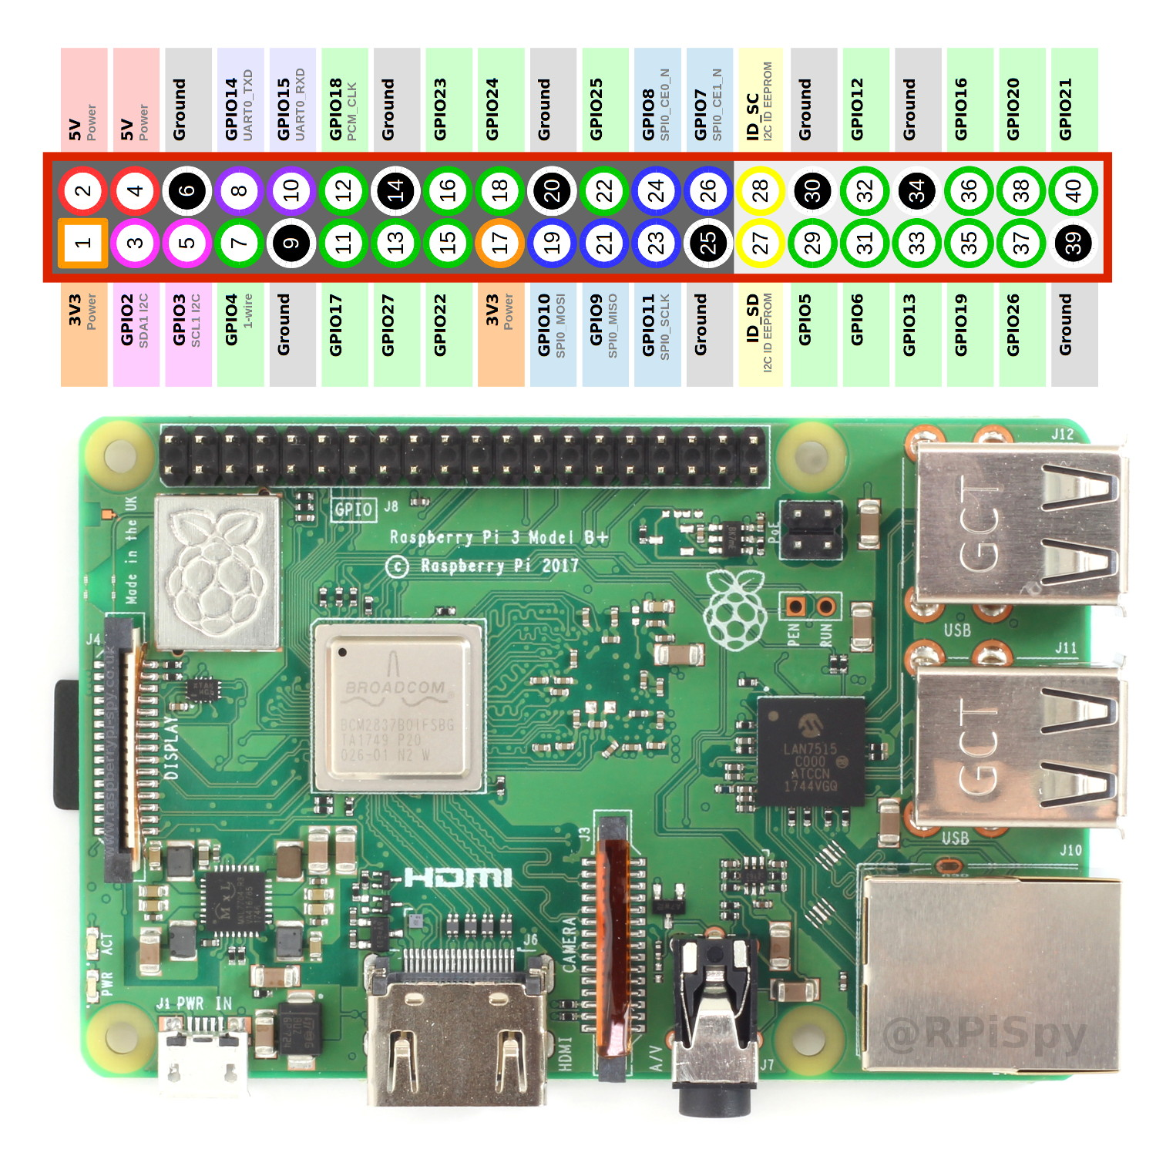


Hardware

Slide 18
Environment

Slide 19
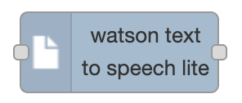
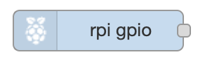

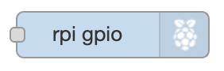
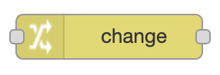


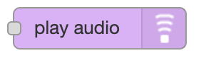


Different Nodes

Slide 20
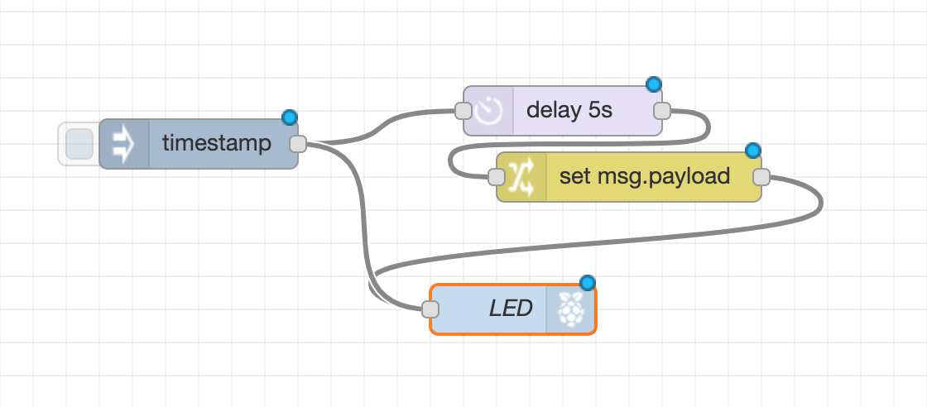
Flows

Slide 21
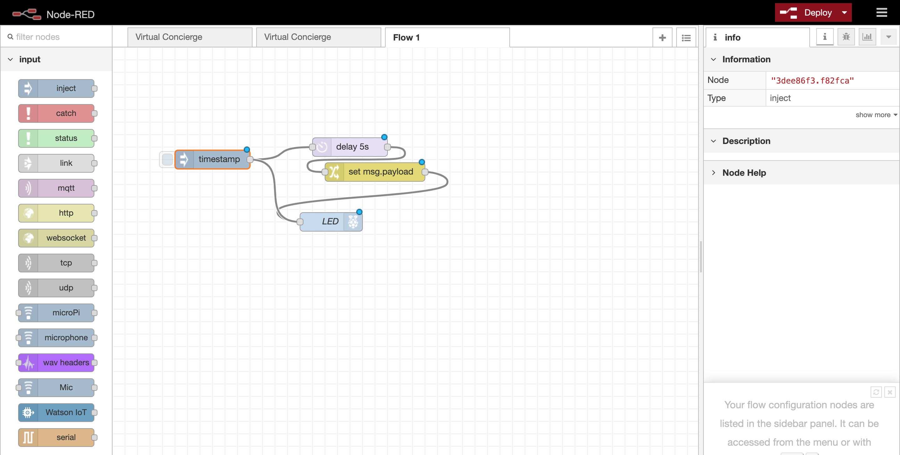

Slide 22
Side Bar

Slide 23
Info/Debugging Window

Slide 24
IBM Watson

Slide 25
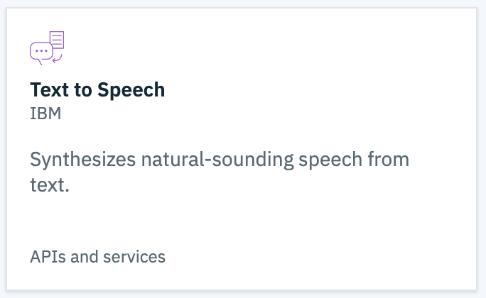
Watson Text-to-speech
DEMO

Slide 26
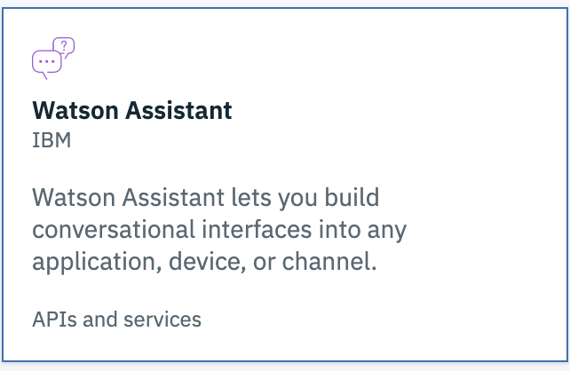
Watson Assistant
DEMO

Slide 27
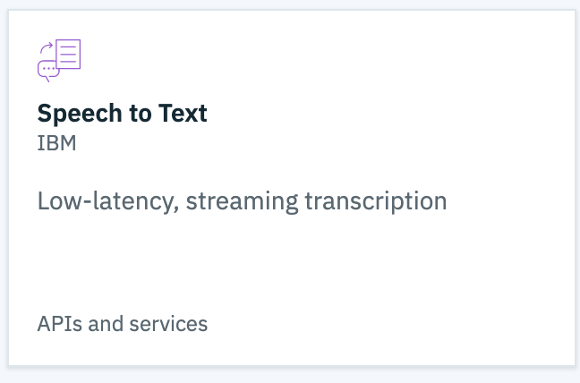
Watson Speech-to-Text
DEMO

Slide 28
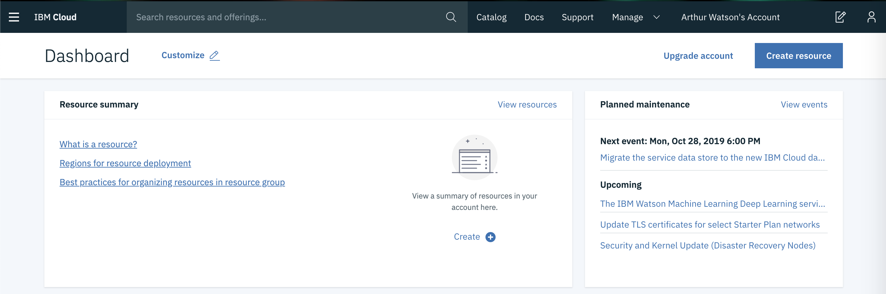
bluemix

Slide 29
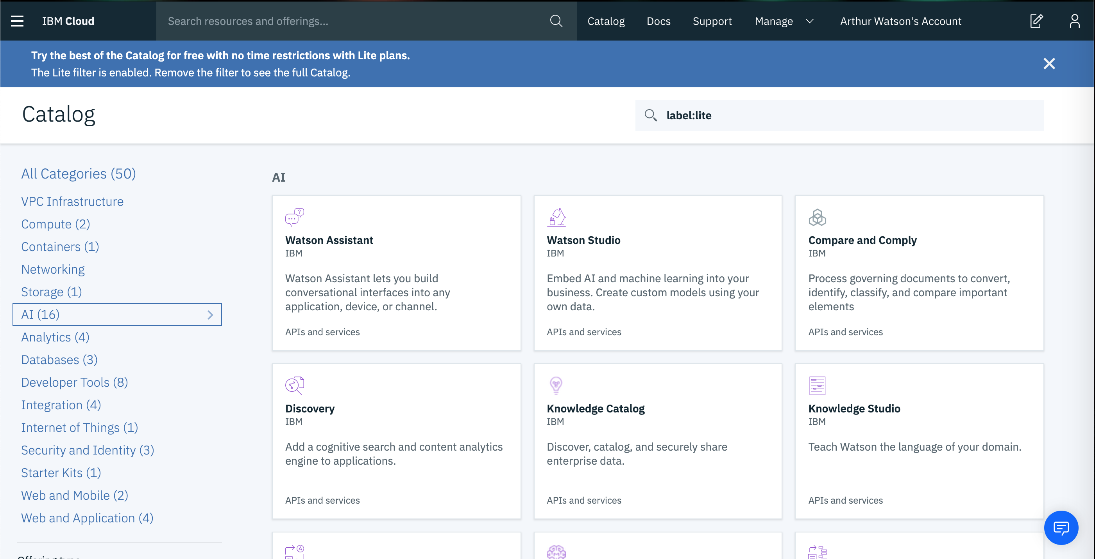

Slide 30
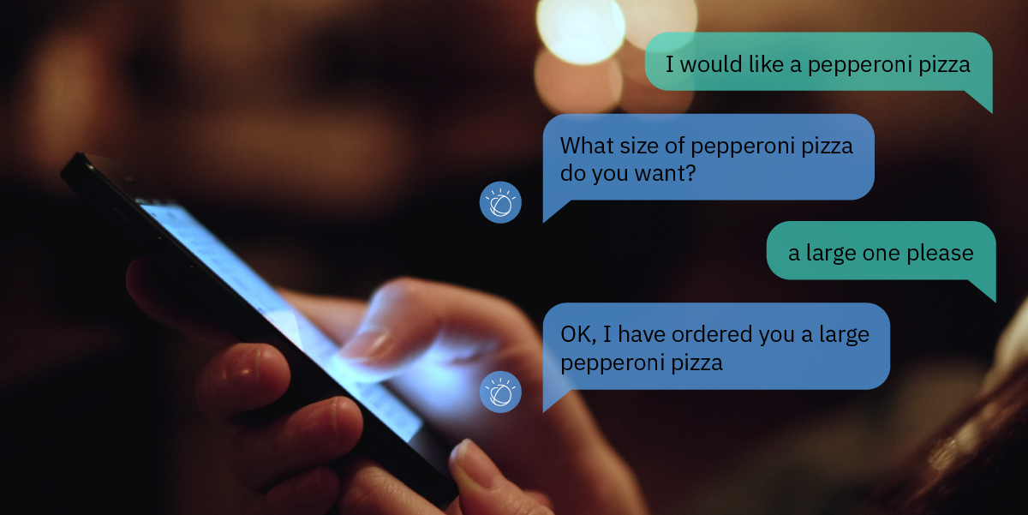
Making a chatbot

Slide 31
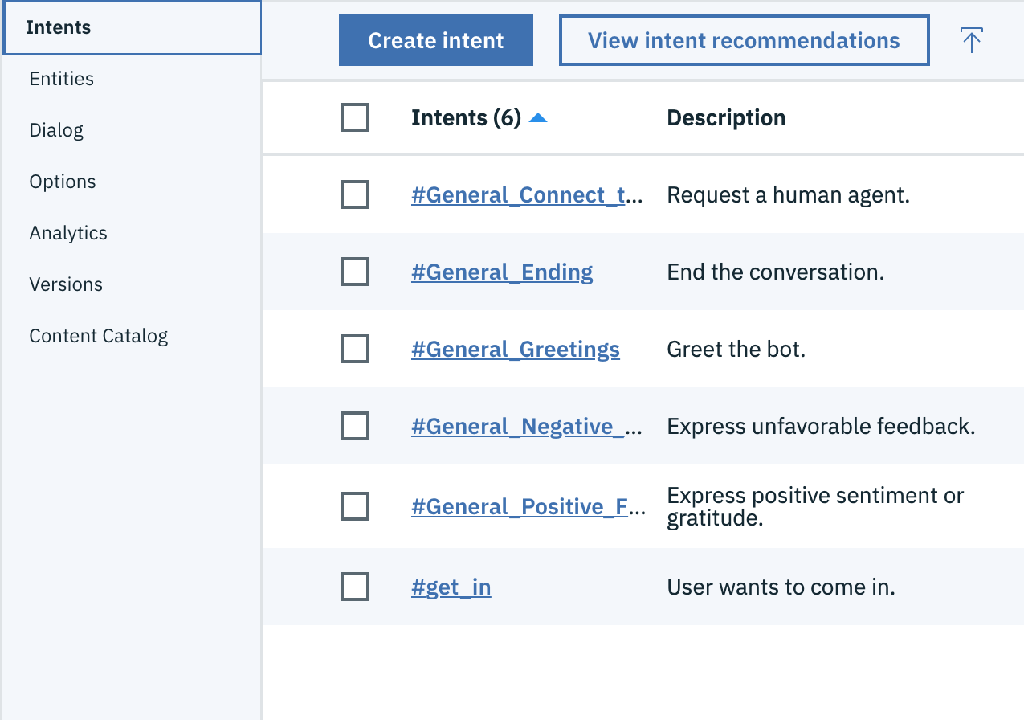
Intent
Intents are purposes or goals that are expressed in a customer's input

Slide 32
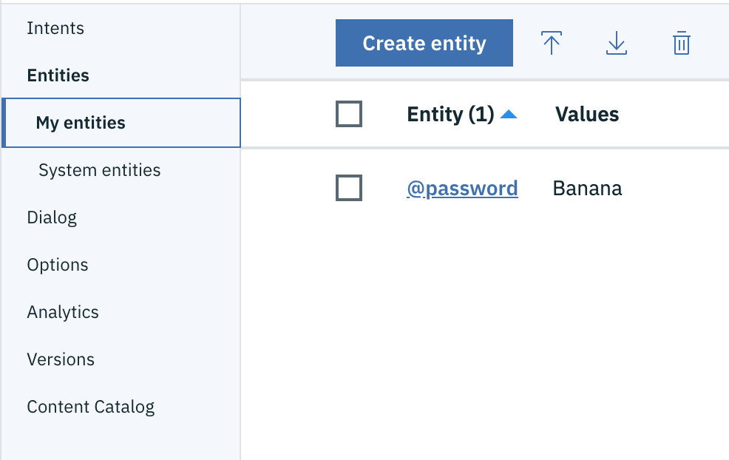
Entity
Looks for a Specific word the user said to Watson

Slide 33
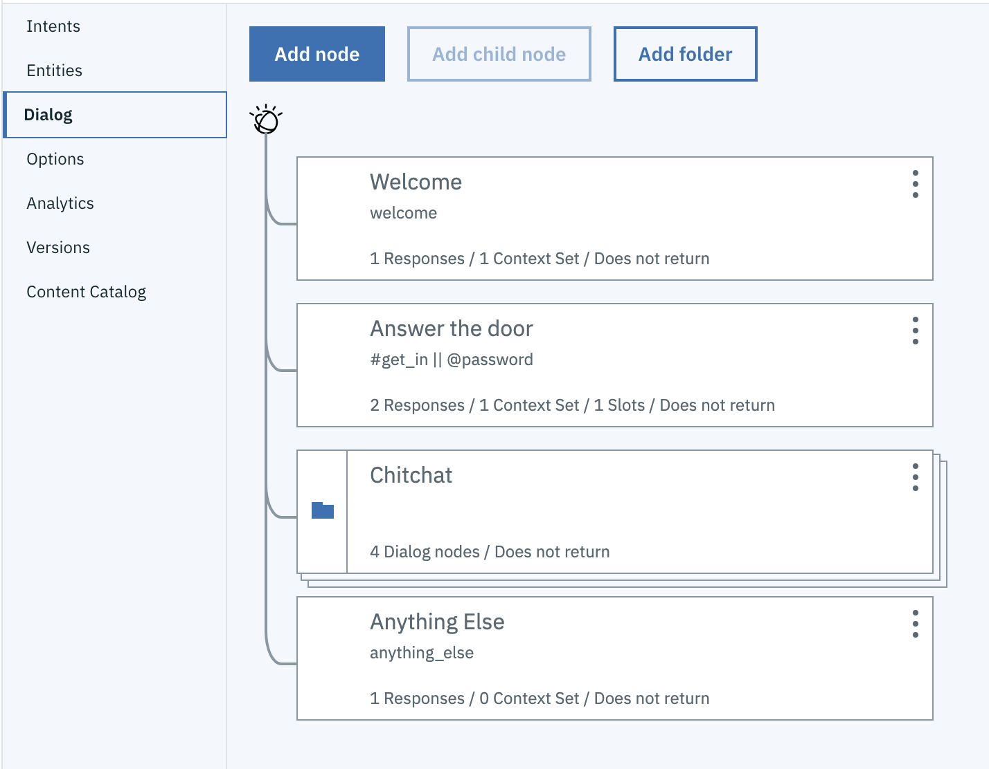
Dialog
The dialog uses the intents, entities, and context to provide feedback to the user

Slide 34
RECAp

Slide 35
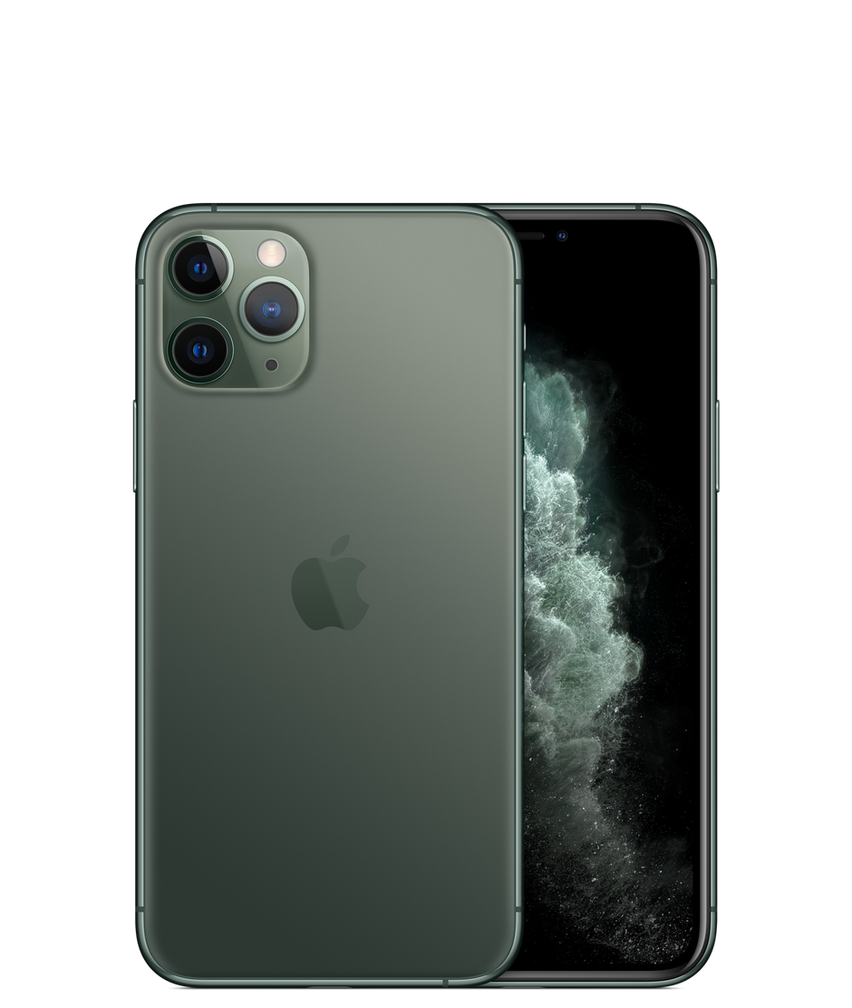



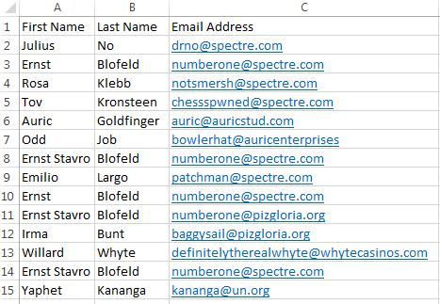
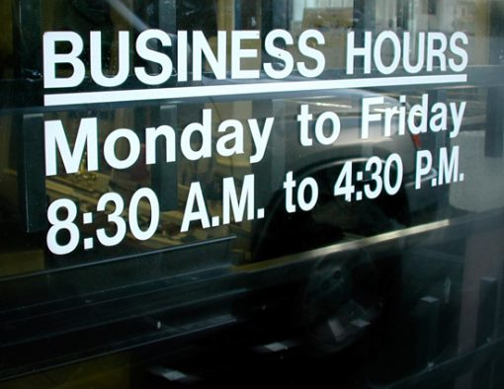
Other Ideas
Ask if open, or set a do not disturb.

Slide 36
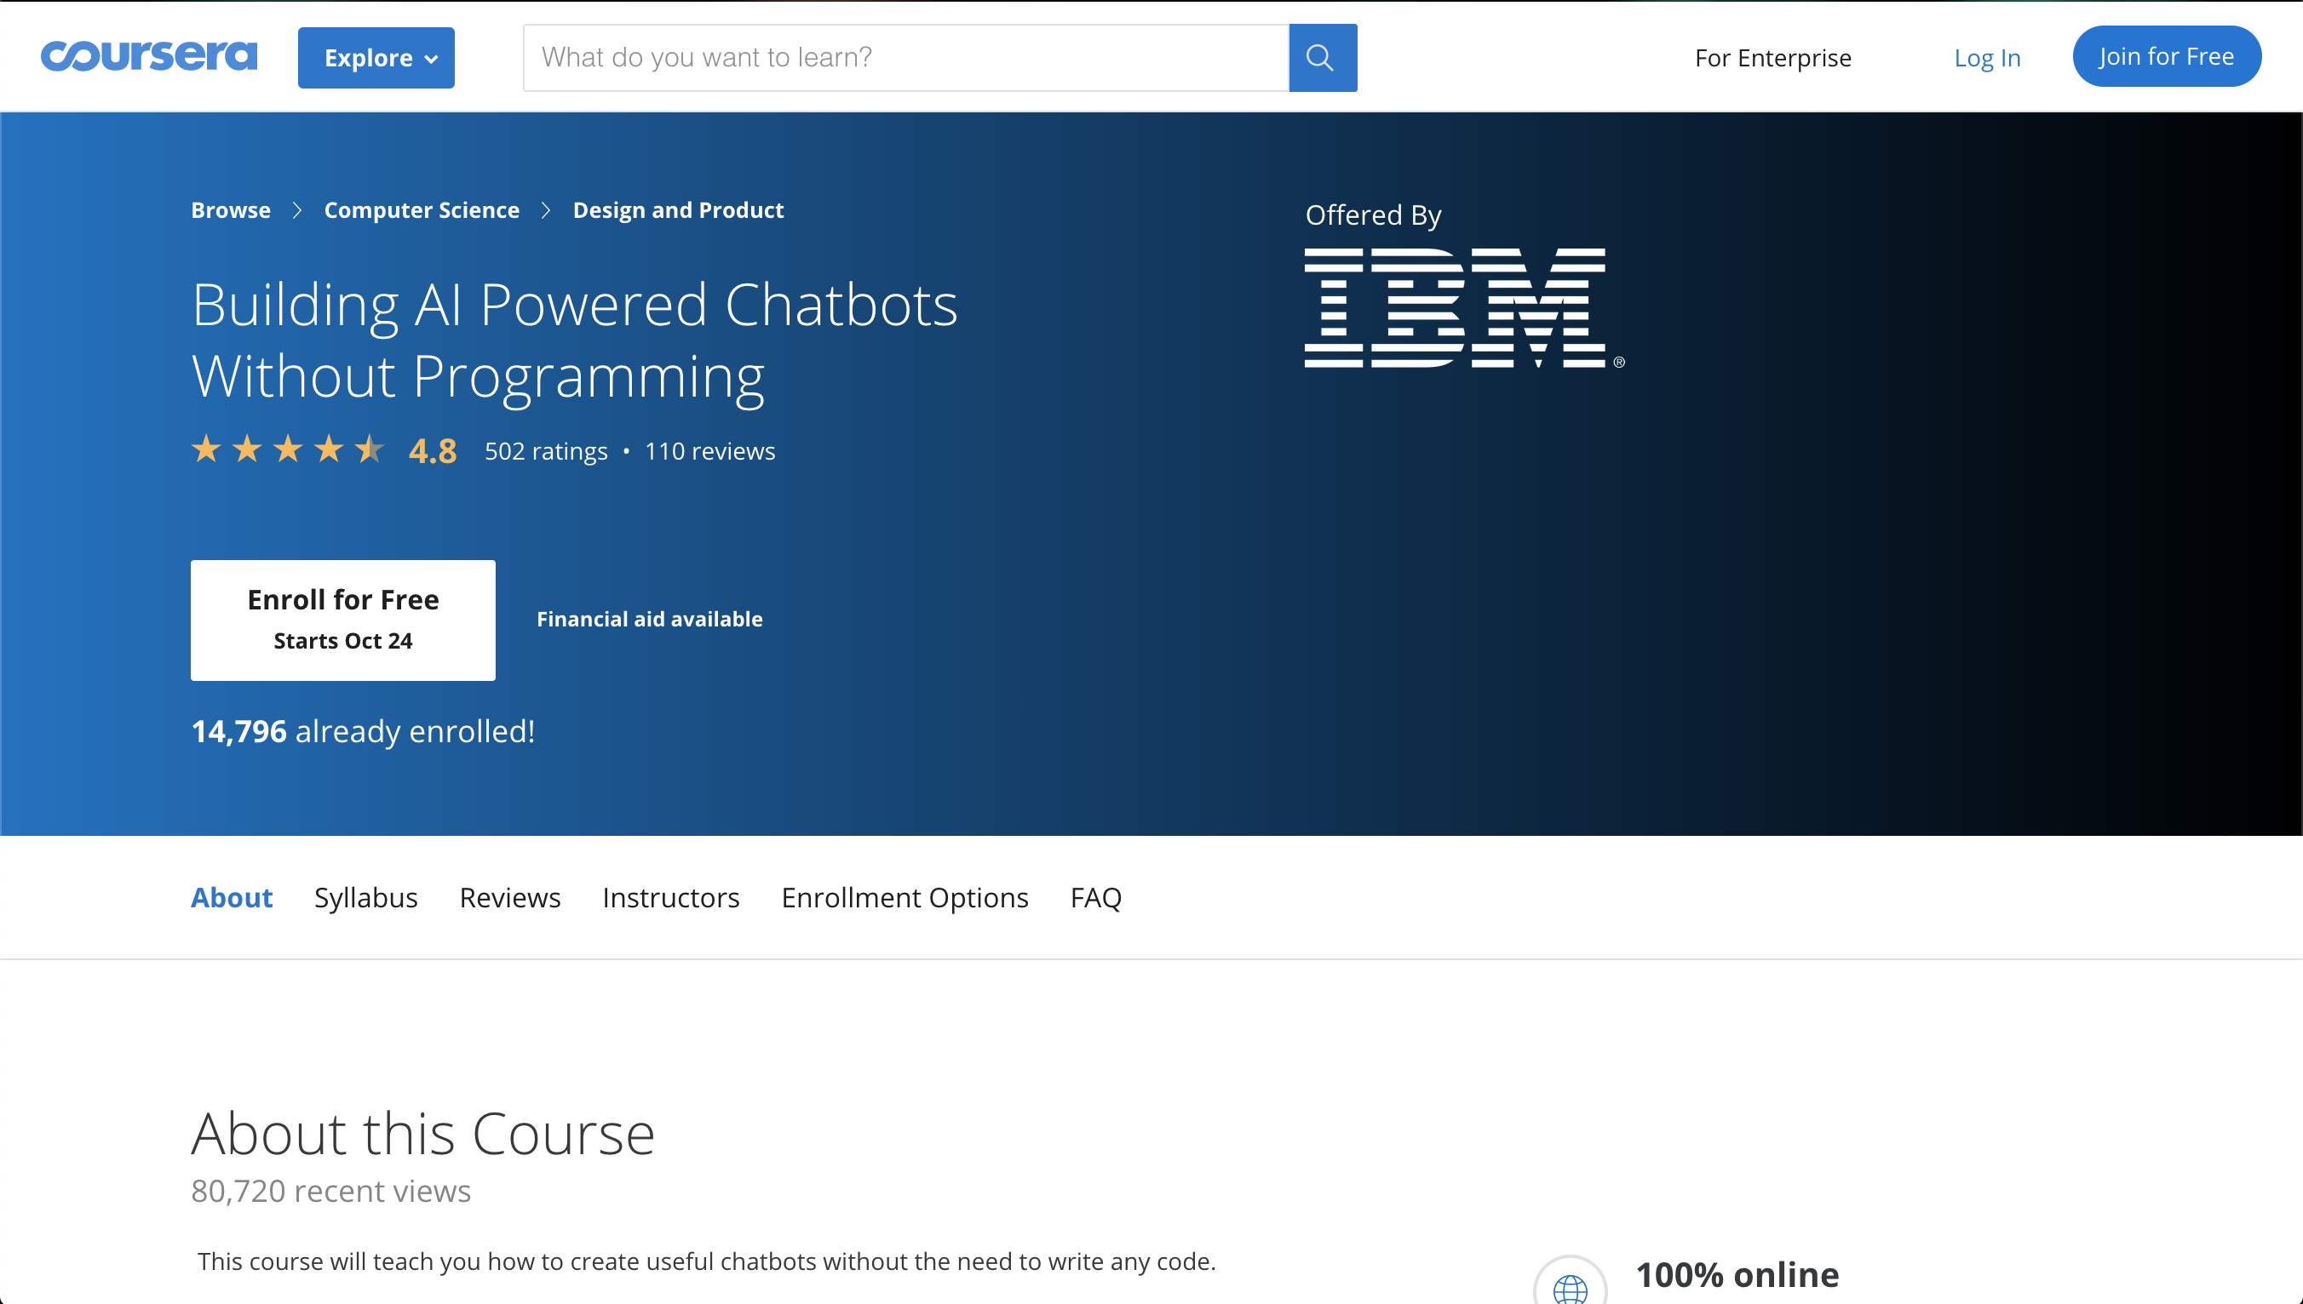

Slide 37
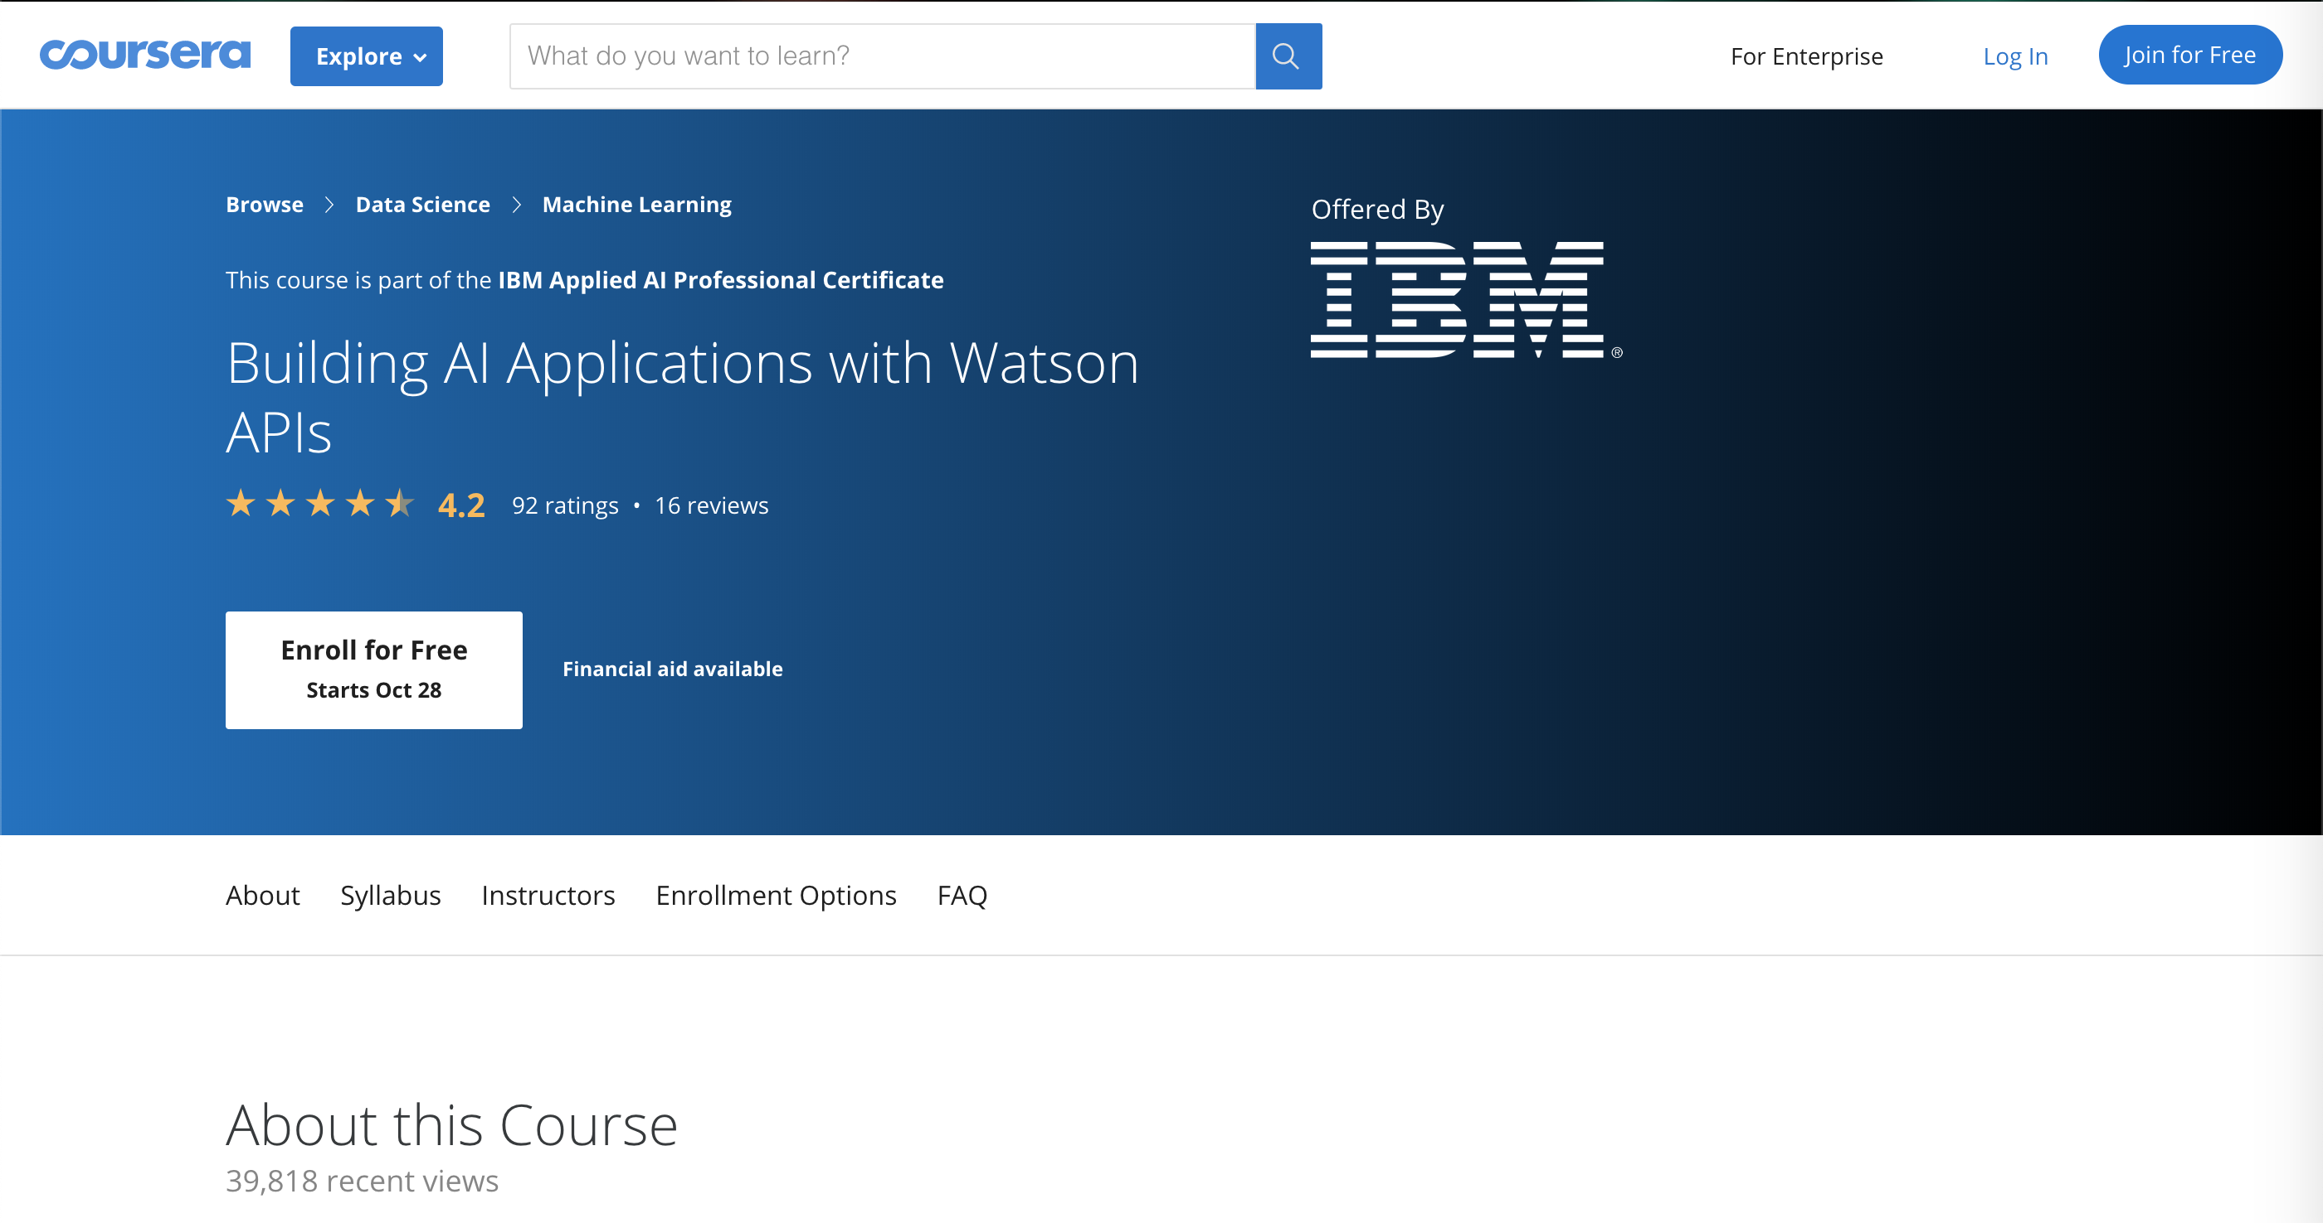
Other Resources

Slide 38


Slide 39
Contact Us
Eric Quan
Matthew Grech
https://www.linkedin.com/in/shengxu-quan1/
shengxu@ibm.com
https://www.linkedin.com/in/matthew-grech-6b6a56162/
mgrech@ibm.com

